Slide 1

Vaibhav sai siddhartha dasari srm university ap ap22110010117 2022-2026

Slide 2
Project title:- Portfolio site creation using html,css,javascript problem statement:-
To Design a comprehensive and user-friendly digital student portfolio system that enables students to effectively showcase their academic achievements, skills, and extracurricular activities. The system should allow for easy uploading, organization, and display of various types of content, including documents, multimedia, and personal reflections

Slide 3
AGENDA
The agenda is simple that is to create a portfolio which includes all our details.
We use vs code to do this. We use 3 components in vs code to perform this.
Html:- Html is used to develop the whole body we include all the info.
Css:- Css is used to design the whole page.
Java script:- We use js to make the portfolio interactive.
These are the languages we use to develop the portfolio.

Slide 4
PROJECT OVERVIEW
Title of the project : student portfolio creation
Objective : To Design a comprehensive and user-friendly digital student portfolio system that enables students to effectively showcase their academic achievements, skills, and extracurricular activities.
Key features :
About yourself
Education details
Skills
Projects
Resume

Slide 5
WHO ARE THE END USERS of this project?
Students : Students use the portfolio to document and showcase their academic achievements, skills, and personal growth. It serves as a tool for self-reflection, goal setting, and tracking progress over time.
Assessors and Mentors: Teachers use student portfolios to assess students' work, provide feedback, and identify areas for improvement. Portfolios help educators tailor instruction to meet individual student needs and monitor their development.
Evaluators for Admission and Recruitment: Colleges and employers may review student portfolios as part of the admissions or hiring process. Portfolios provide a comprehensive view of a student's skills, achievements, and experiences beyond standardized test scores and resumes.

Slide 6
YOUR SOLUTION AND ITS VALUE PROPOSITION
We used vs code and in vs code we used html, css, javascript.
Using html we can structure the whole body. We give our information here. And we can make the website look good by adding all the required css. We use javascript to make the page interactive.s we use above mentioned to get our required portfolio.

Slide 7
How did you customize the project and make it your own
I have customized the design, content, and functionality to reflect my individual style, skills, and experiences.
Designed a custom color scheme
Different elements have different properties.

Slide 8
MODELLING
We have used table layout for organized information presentation.
Header and footer are used
Html is used for structure designing , css for styling, java script for interactive features.

Slide 9
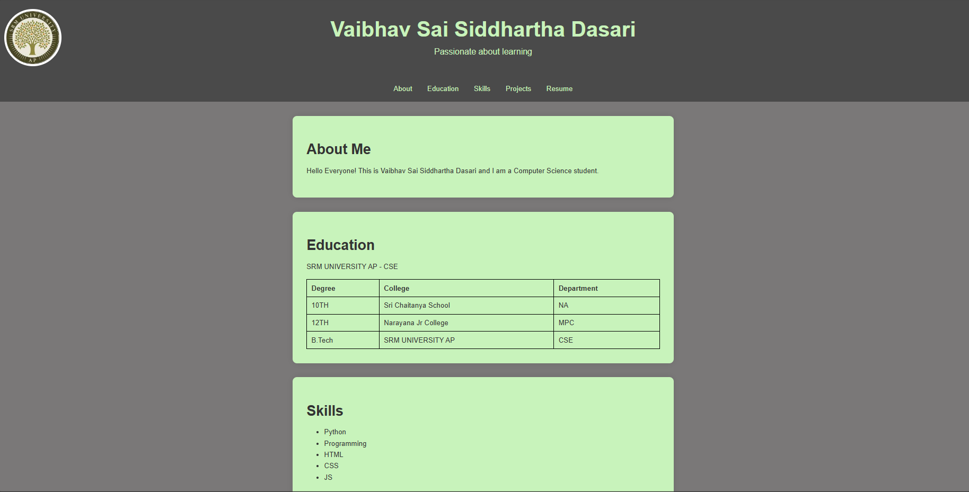

Results

Slide 10
links

